Slide 1
The Litter Survey in Sweden
Joakim Malmdin, Statistics Sweden

Slide 2
Background
The littering in Swedish cities has probably increased the last years. The assumption is not confirmed.
In 2007 commission by The Keep Sweden Tidy Foundation to develop a method for measuring the littering.
We are interested in the littering in central city areas.

Slide 3
Keep Sweden Tiny
The Keep Sweden Tidy Foundation started 1983 and is a non-profit organisation.
The foundation creates public opinion and focus on environmental issues and extensive campaigns.
Influence people´s attitudes and behavior.

Slide 4
The task
The task for Statistics Sweden – find at method for measurement of litter in central city areas.
We strive for
  an unbiased method of selection,
  an effective pre-selection technique,
  to measure neither the dirtiest nor the cleanest locations in the central city areas,
  working with educated survey teams who count the litter.

Slide 5
Where to measure
Measure the littering on pavements – an area of asphalt, cobbles or concrete located adjacented next to a road.
The pavement is demarcated by the kerb and an obstruction (house wall, flower border etc.).

Slide 6
Finding the observation spots
The National Road Database (NVDB) with road/street centre-lines from Swedish Road Administration is used for sampling.
The information from NVDB is combined with the definition of central city core from the municipality.
Centre-line coordinates every fifth meters.
A random selection of 200 potential litter sites is generated.

Slide 7
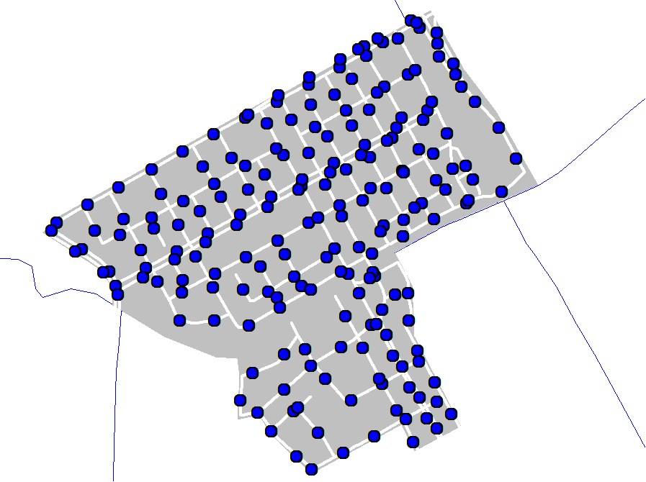
Sample points in central city

Slide 8
Target population: Pavements in central city
Frame population: Objects in the frame population (line objects from NVDB) are spots every fifth metre along the line objects.
Sample design: Stratified systematic sample. The stratification is decided by the municipality. Within each strata, central city area, is a systematic sample drawn.

Slide 9
Sampling and data collection
200 sample points within the central city is taken.
Each sample point is a five metre long section of the pavement of varying width. The surface is measured every half metre.
The coordinates are drawn systematically and then sorted by when they were drawn.
We avoid systematically biased effects of weather and street-cleaning.

Slide 10
Observation period
The recommended length of the observation period is two to four weeks.
This in order to cover variation in weather and other possible conditions.

Slide 11
Rejected sites
Sites were rejected if they were located on
  major European highways/motorways,
  a construction area,
  industrial/private land,
  within a tunnel or bridge,
  an outdoor restaurant or café,
  parked cars or containers,
  a railway or tramway.

Slide 12
Equipment and technique
Measuring tape, paper, pen, map and a GPS-receiver.
Coordinates of where the sample points located accesible on a web page with links to satellite images.
If a spot is located alongside the pavement, the nearest pavement is chosen.

Slide 13
Technique, cont.
The direction of the pavement to be measured is chosen in turn; north, east, south, and west.
If the road has two pavements, both are measured.
The maximum width of a pavement is set to five metres.
All kind of litter is registred and classified according to a list in the field. Results transmitted to the data base via a web page, maintained by Statistics Sweden.

Slide 14
Categories of litter, example
Cigarette butts
Paper
Glass
Hard plastic
Soft plastic
Metal – bottle caps
Organic material
Candy packaging
Other materials

Slide 15
Interpreting the results
It is not straightforward to compare the results between the cities.
The criteria for which areas that are to be chosen are not given in the design plan, but decided upon by the representatives from each city.
The strength lies in the collection of time series and thereby comparable estimates from year to year.

Slide 16
Communicating the results
The results are published by The Keep Sweden Tidy Foundation in cooperation with Statistics Sweden for statistical and methodological advices.
In the information sheet we present the five categories with the most numer of litter items found.
We also provide a table where the litter found is categorised by the days of the week (Monday to Friday).

Slide 17
Thank you for listening!

