Slide 1
Effect of the revised publishing system on the development of the contents of Statistics Finland’s free data supply
Nordisk Statistikermøde, København, august 2010
Tema 4: Formidlingen
Riia Arvela
riia.arvela@stat.fi

Slide 2
Statistics Finland aims to bring statistical data into use by extending free data supply on the Internet
This is supported by the new Fast-Web-XML publishing system suited for multi-channel publishing by means of which basic statistical publications are produced
What effects has the change had?

Slide 3
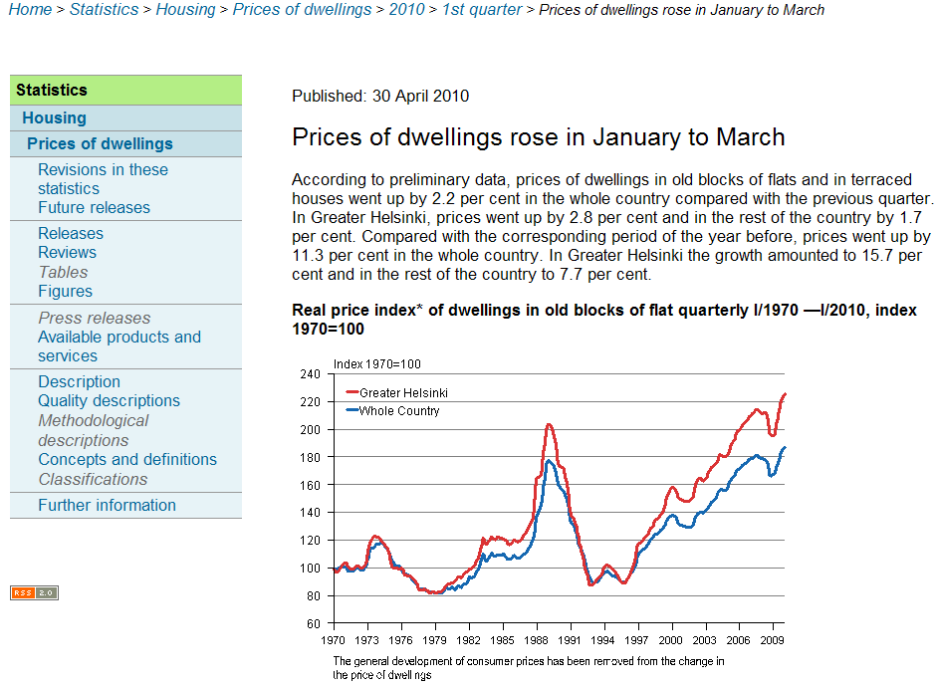
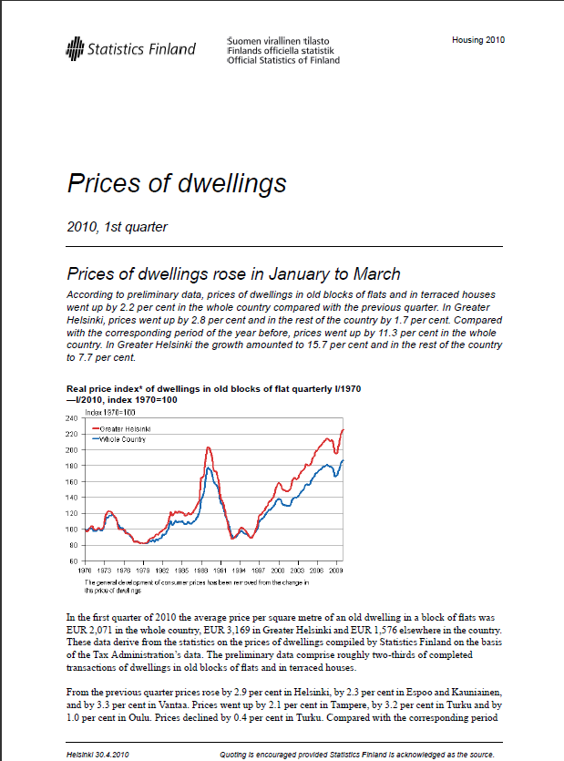
Formation of the basic publication
Basic publication (XML document)
Statistical release Fi, Sw, (En)
Title
HTML
Fi, Sw, (En)
Lead (first paragraph)
Figure or table
Short text
Contact details
PDF
Extensive text and/or appendix tables
PDF Fi, ( Sw, En)
Printed publication
( Fi, Sw, En)
Figures
Quality descriptions

Slide 4
Connections of the basic publication to the rest of the website
Sections supplementing
the basic publication
Basic publication (XML document)
StatFin-database
Statistical release Fi, Sw, (En)
Metadata
Title
Description
Lead (first paragraph)
Methodological descriptions
Figure or table
Concepts and definitions
Short text
Classifications
Contact details
Datalists
Extensive text and/or appendix tables
Tables and figures of chargeable services
Figures
Articles
Quality descriptions
Compendiums

Slide 5
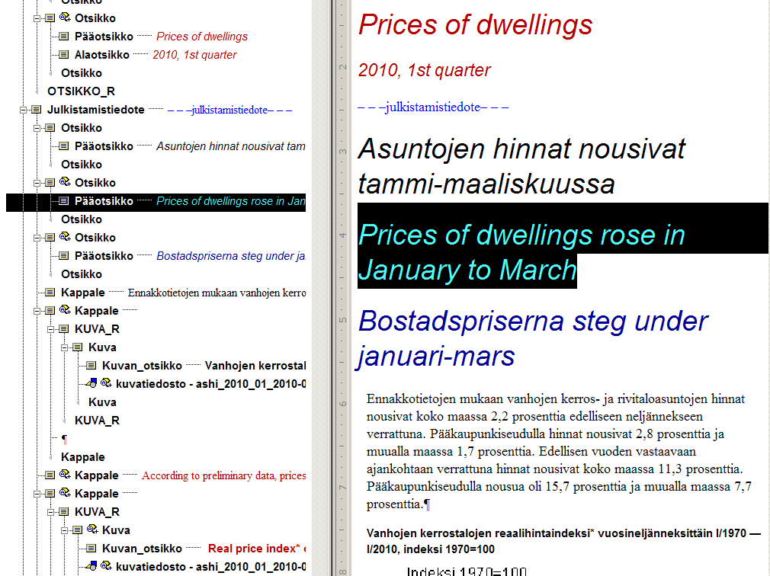
Production of an XML document for a basic publication
Arbortext Editor:

Slide 6
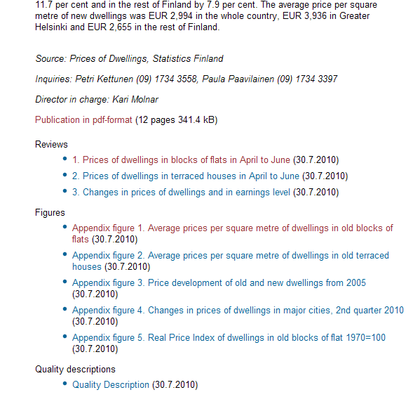
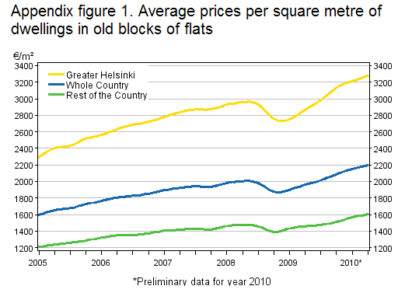
Basic publication html

Slide 7
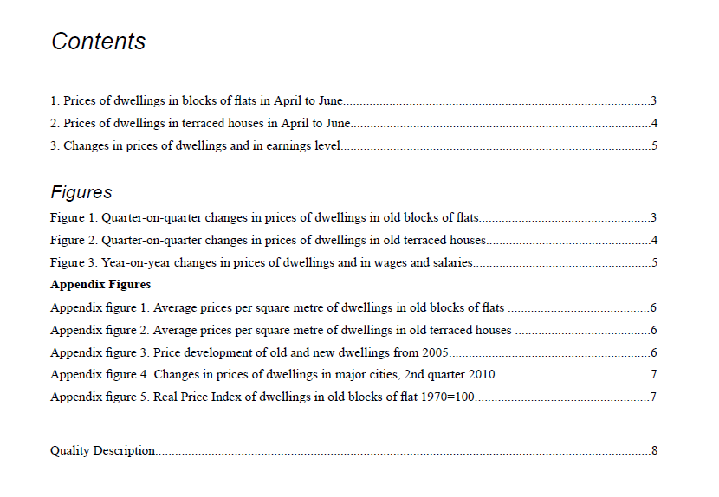
Basic publication PDF

Slide 8
StatFin database
Database tables of prices of dwellings (only in Finnish)
StatFin database in English

Slide 9
Some numbers…
We have been able to increase free data supply
Number of statistical releases in 2010: in Finnish and Swedish 610 in English 390
Number of tables in the StatFin datadase: in Finnish 1,286 in Swedish 350 in English 329

Slide 10
What will users of data get because of the change?
Now:
More uniform data supply from statistics with more uniform appearance
Closer connection between the content of basic publications and database tables
More comprehensive data in Swedish and English
In future:
Even more uniform and high quality basic publications
Ever easier to find data
Services focused more precisely on customer groups

